Slide 1



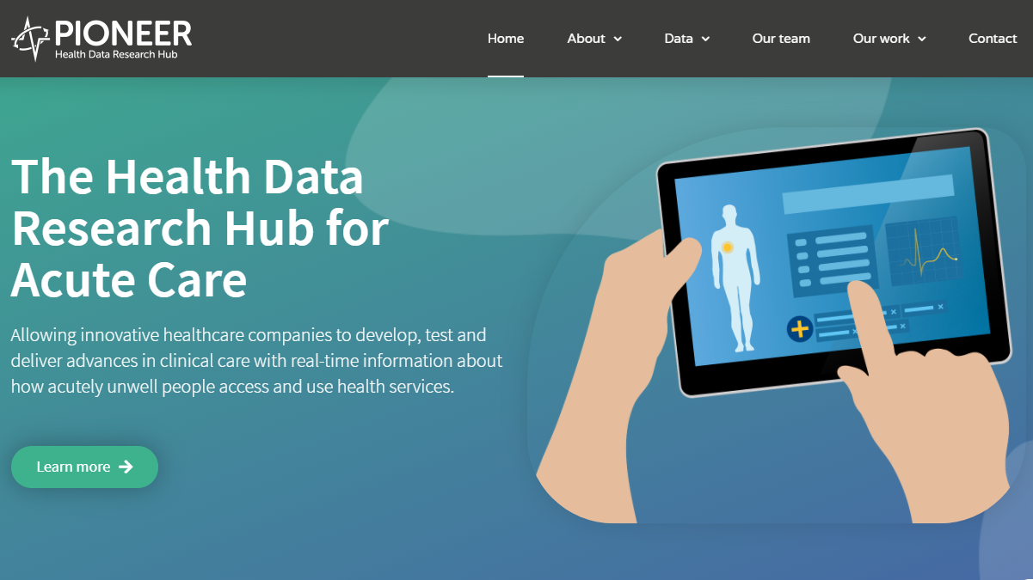




ABOUT US
PIONEER: The Health Data Research Hub for Acute Care
Our Funders
Our Partners
Notes:
PIONEER, the Health Data Research Hub for Acute Care, is funded by UK Research and Innovation and delivered in partnership with Health Data Research UK.
Founded in 2019, PIONEER was built upon the substantial expertise of digital health, data curation, data sharing under license and analytics of UHB and UoB
In partnership with ENSONO and Microsoft we have built an cutting-edge, secure and private cloud-based data haven with the ability to build and run bespoke analytical environments to suit a customer exact requirements
Our primary aim is to improve the health and well-being of patients through increased understanding of acute illness, better diagnostic timelines, healthcare pathways and treatments
We achieve this through responsible and patient/public-endorsed data sharing under license and supported analytics and consultancy
Our objective is to allow innovative healthcare companies to develop, test and deliver advances in clinical care utilising real world data
With robust governance and ethics in place, this data can then be used to develop new methods of predicting, diagnosing and monitoring illness in hospital and at home; improving treatment choice and identifying new ways of delivering clinical care.

Slide 2











OUR AIMS
How PIONEER works
Understand acute illness
Improve understanding
Responsible data sharing
Deliver advances
Notes:
Acute Care is any unplanned health episode, 110 million urgent same-day patient contacts
Around 85 million of these are urgent GP appointments, and the rest are A&E or minor injuries-type visits.
Some estimates suggest that between 1.5 and 3 million people who come to A&E each year could have their needs addressed in other parts of the urgent care system.
There are known health inequalities and the increased demand for emergency services has a significant impact on planned NHS services
Chronic disease accounts for two-thirds of emergency medical admissions
10% of acute presentations are the new diagnosis of a chronic illness, at a late stage

Slide 3
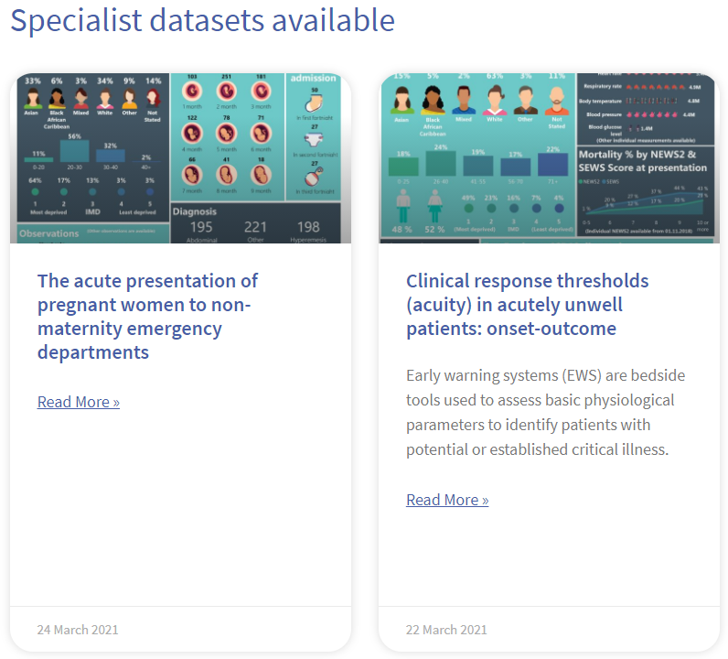











DATA OVERVIEW
WHAT DATA DO WE HAVE?
Attendance Reason
Operations/ Procedures
Medications / Allergies
Vital Signs
Laboratory Tests
Imaging Reports
Complications / Diagnosis
Severity
Patient Transfers
Final Outcome
Outpatient Care
Notes:
the UK has some of the richest health data in the world, making it possible to make national-scale improvements to health and care
PIONEER is the most complete record of the acute health care journey available for research and innovation
PIONEER is disease-inclusive, focusing on the patient in their entirety without a disease or organ-based approach, and is ageless, including data from both children and adults.
Our data is routinely collected from the electronic health record systems of participating healthcare providers and is updated at least weekly.
It includes both presenting symptoms and patient demographics including (but not limited to) age, ethnicity and multimorbidity.

Slide 4




DATA SERVICES
DATA LICENSING
DATA SERVICES AVAILABLE
Data access is licensed
Data cannot be shared
Data is sufficient for the study
Data extraction &
Transformation
Enrich Data
Bespoke Dataset
Consulting Services
Customer A: TRE
Notes:
the UK has some of the richest health data in the world, making it possible to make national-scale improvements to health and care
PIONEER is the most complete record of the acute health care journey available for research and innovation
PIONEER is disease-inclusive, focusing on the patient in their entirety without a disease or organ-based approach, and is ageless, including data from both children and adults.
Our data is routinely collected from the electronic health record systems of participating healthcare providers and is updated at least weekly.
It includes both presenting symptoms and patient demographics including (but not limited to) age, ethnicity and multimorbidity.

Slide 5




APPLICATION PROCESS
STEPS TO ACCESS
Application
Review
Approve
Commercials
Access
Process 1
Process 2
Process 3
Process 4
Process 5
Notes:
the UK has some of the richest health data in the world, making it possible to make national-scale improvements to health and care
PIONEER is the most complete record of the acute health care journey available for research and innovation
PIONEER is disease-inclusive, focusing on the patient in their entirety without a disease or organ-based approach, and is ageless, including data from both children and adults.
Our data is routinely collected from the electronic health record systems of participating healthcare providers and is updated at least weekly.
It includes both presenting symptoms and patient demographics including (but not limited to) age, ethnicity and multimorbidity.

Slide 6

Ralph Evans
Ralph.evans@uhb.nhs.uk

